Slide 1
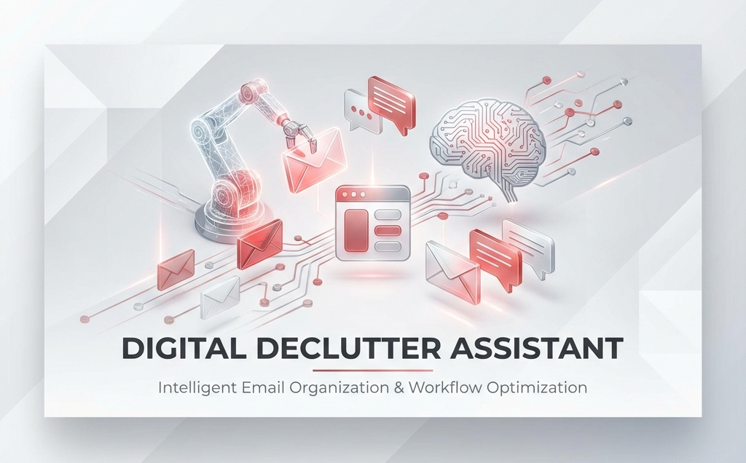

Slide 2
Problem statement
Email is where all important work begins, but also where it gets lost.
Modern professionals rely on their inbox for tasks, deadlines, invoices, follow-ups, and opportunities, yet these critical items get buried under newsletters, promotions, and noise.
As a result:
Important emails are missed
Action items are forgotten
Manual triage becomes overwhelming
Simple filter-based automation fails because it lacks real understanding
There is a need for a smarter system that can truly understand emails, detect what requires action, organize it cleanly, and learn personal preferences over time.
This gap is what the Digital Declutter Assistant solves

Slide 3
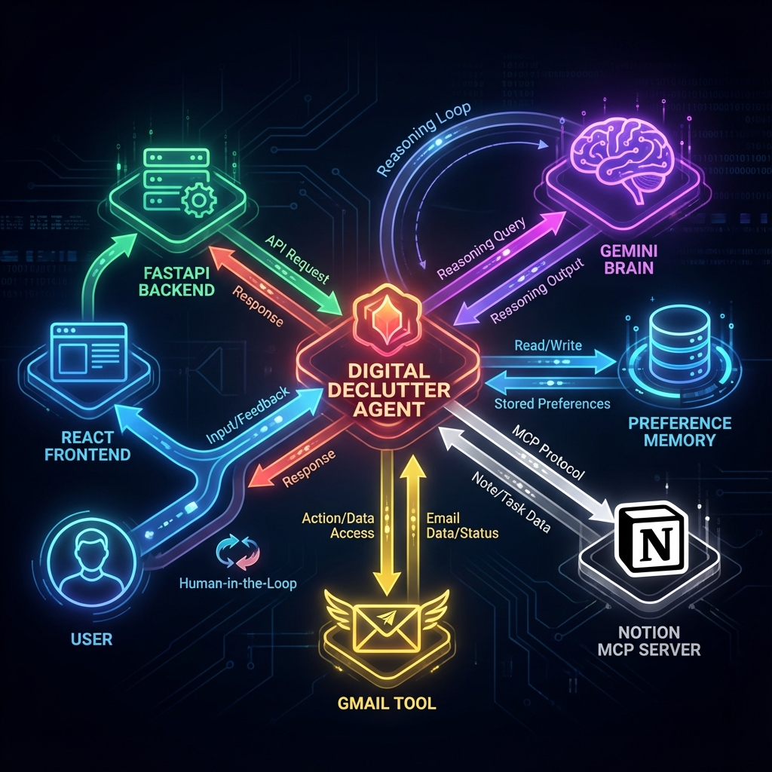
Solution Proposal
High Level
Architecture

Slide 4













Digital Declutter Assistant - Architecture
OAuth
Gmail Custom Tool
FastAPI
Back-end
Python
Fetch
Delete
DigitalDeclutter
(LLM Agent)
Archive
Fetch/update
mail
Session
Context
Planning
OAuth
Front-end
Tool Selection & Execution
Create
task
Notion MCP Server
Interactive Chat
REST
User
React
Create Task
Observation + Proposal
Store/fetch
from memory
User Confirmation
Google
ADK
Long-term
memory
Action Execution + Response
Preference Store
(Memory json)
Rule Lookup
Rule Save

